Slide 1
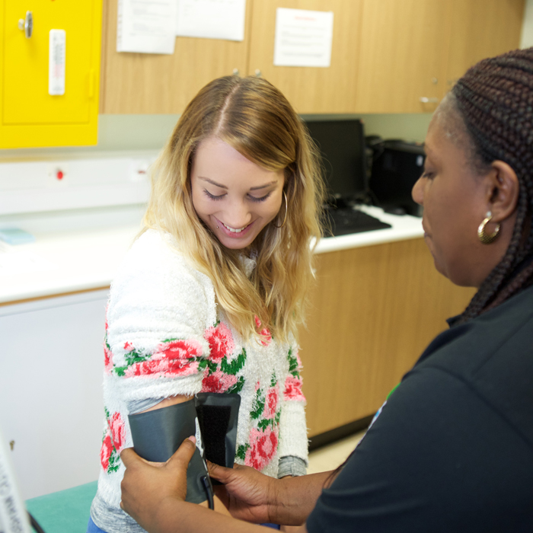
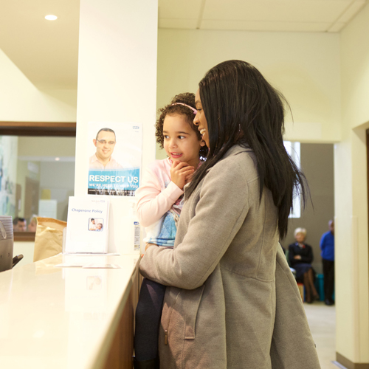
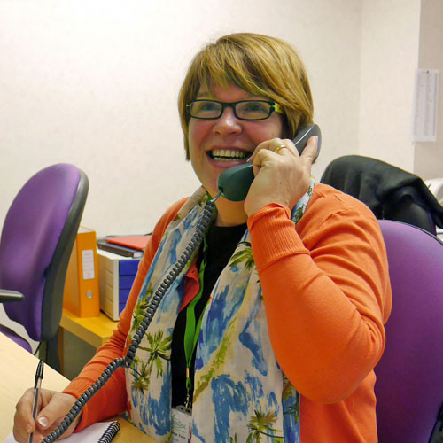
Welcome to the Integrated Urgent Care Service

Slide 2
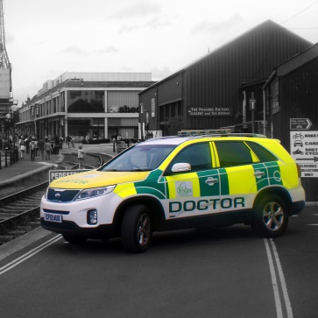
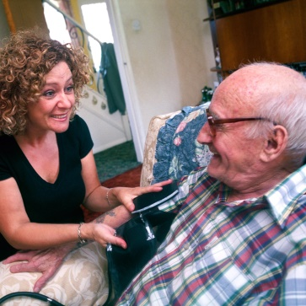
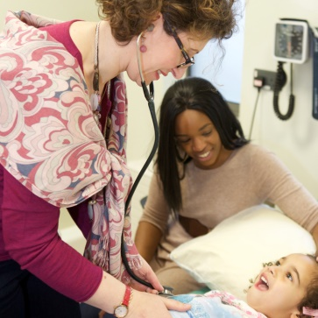
What is the Integrated Urgent Care Service?
SevernSide Integrated Urgent Care (IUC) is the 24/7 NHS Urgent Care Service which combines NHS111 and GP Out of Hours service.
We serve patients across Bristol, North Somerset and South Gloucestershire.

Slide 3
What is the Integrated Urgent Care Service?
The service provides:
24/7 Navigation for patients to the most appropriate service to meet their needs
24/7 Clinical Assessment Service (CAS) to provide telephone consultations for patients and to support healthcare professionals in the community.
Face to face appointments at Treatment Centres during out of hours
Out of hours home visit service from clinicians when appropriate

Slide 4
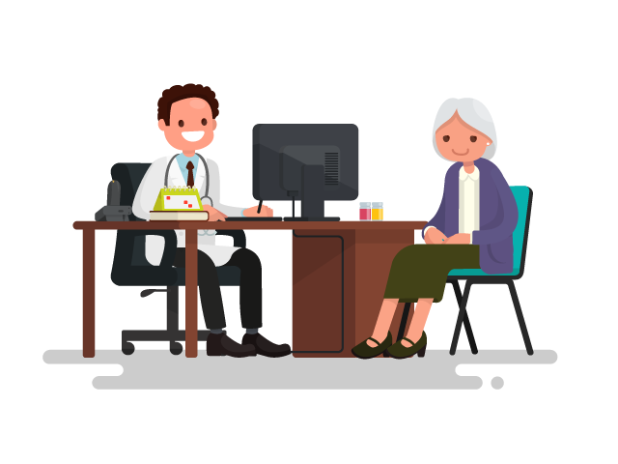
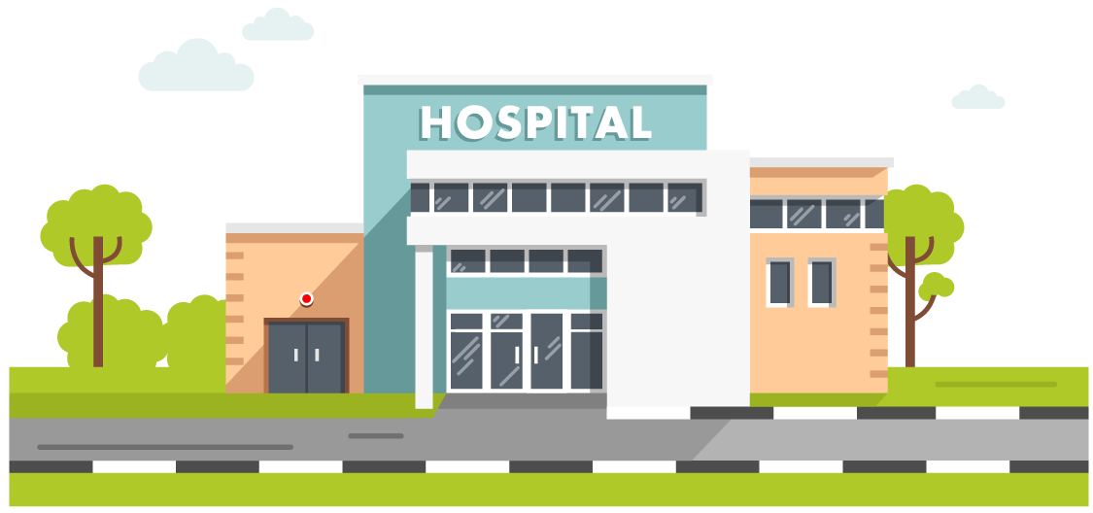
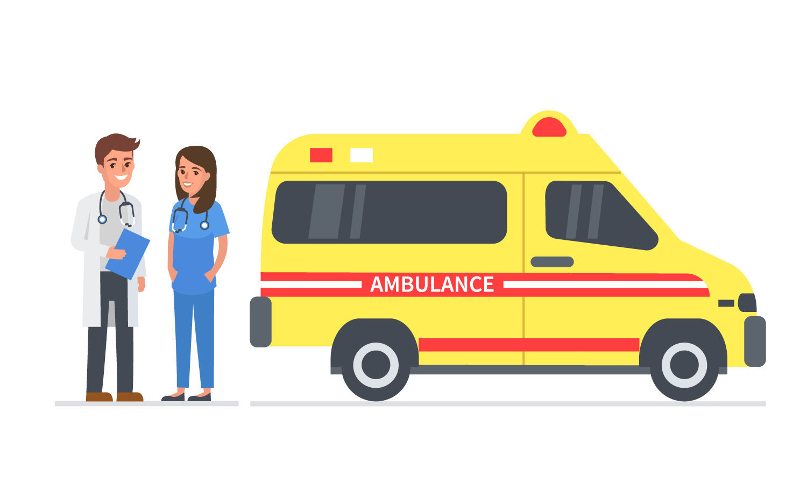
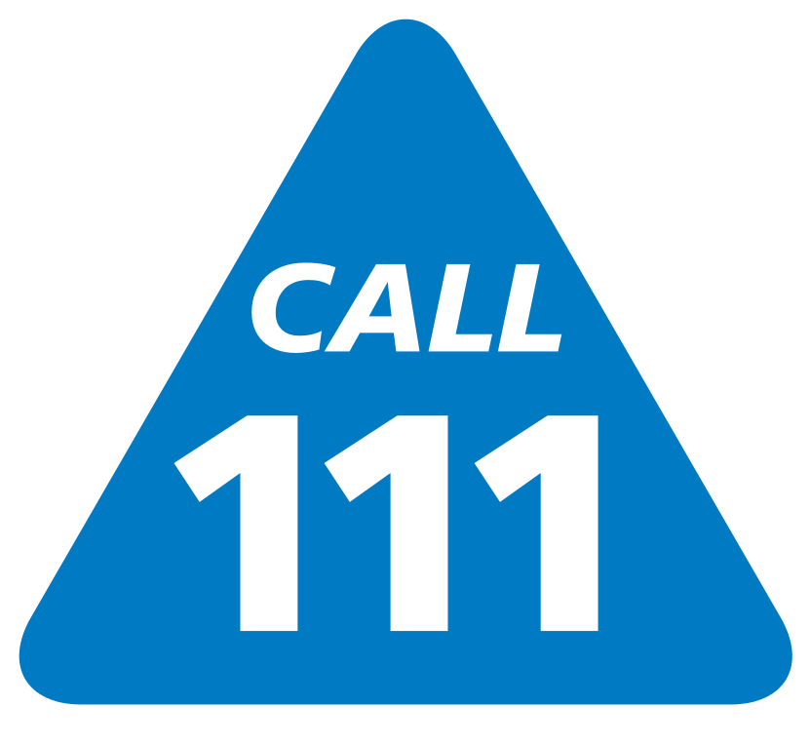
What is the Integrated Urgent Care Service?
As the name suggests, it’s an URGENT care service
That places us somewhere between daytime GP surgeries dealing with routine and long-term health issues and Emergency Services such as A&E and 999 dealing with life threatening conditions.
Your Local GP Surgery
Integrated Urgent Care
A&E / 999
Daytime Routine Care
Urgent Care
Emergency Care

Slide 5
How do patients access the Service?
Accessing the service is simple, you have two options
Dial 111 from a
landline or mobile
Contact NHS 111 Online
or use the NHS app
The service is free to use and available 24hrs a day 365 day a year

Slide 6
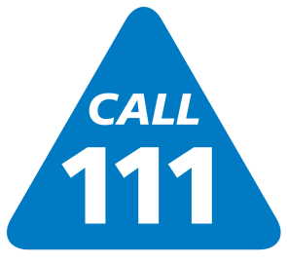
Who is the service for and when is it appropriate for patients to contact NHS111?
NHS111 is suitable for patients who are unsure where to go for medical advice or for patients with urgent health conditions that can’t wait until their daytime GP surgery is open and available to help.

Slide 7
Please remember
As an urgent care service,
we deal with each case in order of urgency, not in order of when the initial call was placed
Hay fever
Diarrhoea
Urinary tract infection
Vomiting
Infant with fever
Possible Stroke
Non-urgent
Urgent

Slide 8
What happens once a patient contacts NHS 111?
An automated system will guide you to the correct pathway
Online
Patient calls 111
Patient contacts 111 online
Your call will be managed by a trained
Healthcare advisor or transferred to a clinician
You may be transferred to a clinician in our Clinical Assessment Service (CAS) or receive a call back within an agreed timeframe
You may be offered a face to face appointment at a Primary Care Treatment Centre
You may be offered a Home Visit
We may arrange for you to be cared for by another service or give self care advice
In an emergency we will arrange an ambulance

Slide 9
Our Treatment Centres & Bases
Bristol
Clinical Assessment Service (CAS) Osprey Court
Nicholson House (NHS111)
Knowle Health Park
Greenway Community Practice Southmead
North Somerset
Clevedon Community Hospital
Weston New Court Surgery
South Gloucestershire
Cossham Hospital

Slide 10
Please share your feedback on the new service
We are keen to learn from the experiences and knowledge of a wide range of patients.
If you have any thoughts or feedback on how we can improve the service contact the SevernSide IUC Governance Team on: severnside.governance@nhs.net

Slide 11
Questions?

Slide 12
For more information please visit:
www.severnside-iuc.co.uk

