Slide 1

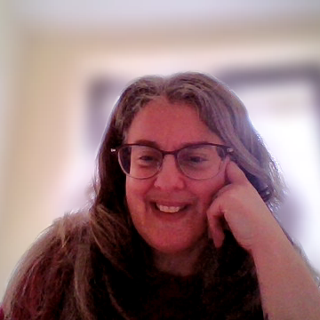
Misogyny Awareness Training
Notes:
Introduce yourself and BWV:
I’m from Bristol Women’s Voice (BWV), a charity created by Bristol women in 2016. We came about after a large-scale, council-funded consultation in 2013 where women consistently said they didn’t feel heard in decision-making. We now have more than 4,000 members and subscribers who help shape our strategic plan and direction. Our goal is to make women’s equality a reality in Bristol. We do this through campaigning, connecting, and celebrating. This training is part of our campaign to bring our values and understanding to as many people in Bristol as possible. We hope you enjoy it and are looking forward to your participation and feedback.
We’re going to be talking about identifying and understanding misogyny and sexism.

Slide 2
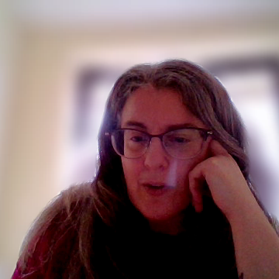
Misogyny Awareness Training
Learning Outcomes
Understand what misogyny is
Give learners practical skills for recognising and resisting it in their lives and workplaces
Understand how misogyny interacts with other forms of oppression
Understand the impact of misogyny and the need for individual and collective care

