Slide 1
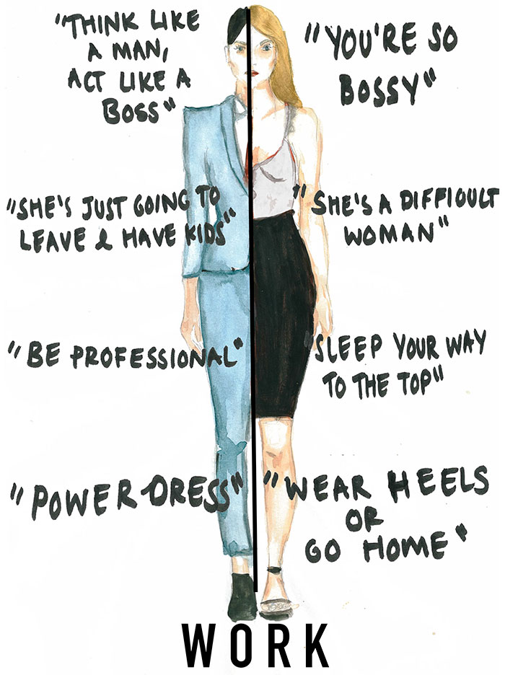
Sexism and Misogyny
This Photo by Unknown Author is licensed under CC BY
Notes:
I’m hoping that the videos showed you how sexism and misogyny are inter-related – they are separate concepts but interlinked. Sometimes they get used interchangeably but they are not the same – and shouldn’t be treated as such.
We have a short quiz for you to help you identify what each sound like in everyday life. Then we’ll give you some time to work through definitions.

