Slide 1
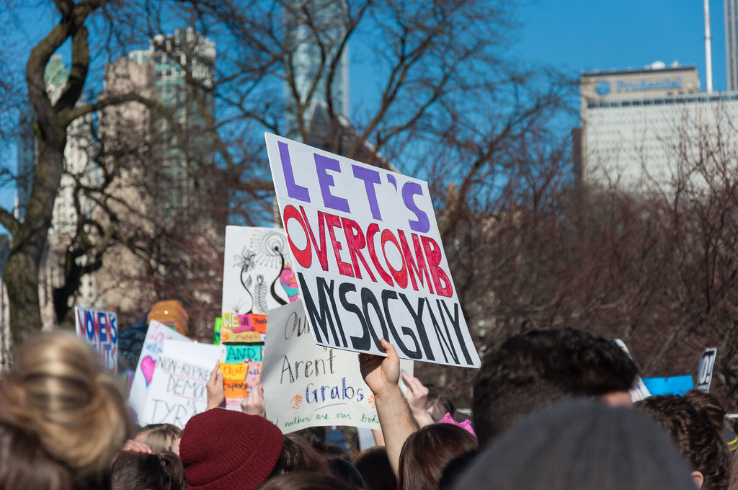
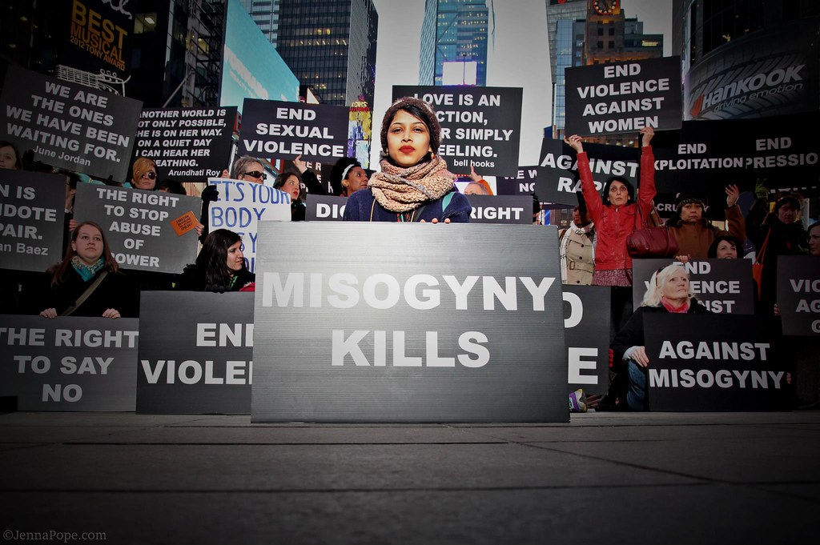
Impact
This Photo by Unknown Author is licensed under CC BY
This Photo by Unknown Author is licensed under CC BY-SA-NC
Notes:
We’re going to spend some time thinking about the impact of misogyny.

